Slide 1
Tools for Continuous Integration in Software Development

Slide 2
Continuous Integration Techniques
Continuous Integration is a software engineering practice in which isolated changes are quickly tested and reported on when they are added to a larger code base.
The goal is to rapidly provide feedback so as to identify and remove any defects in the code as quickly as possible.

Slide 3
Cross Functional Teams
Cross functional teams are composed of members with different skill sets required for the project.
All members will have specialised areas of expertise but will also be proficient in other areas.
Members will write their own tests so there will be no need for a pure tester role.

Slide 4
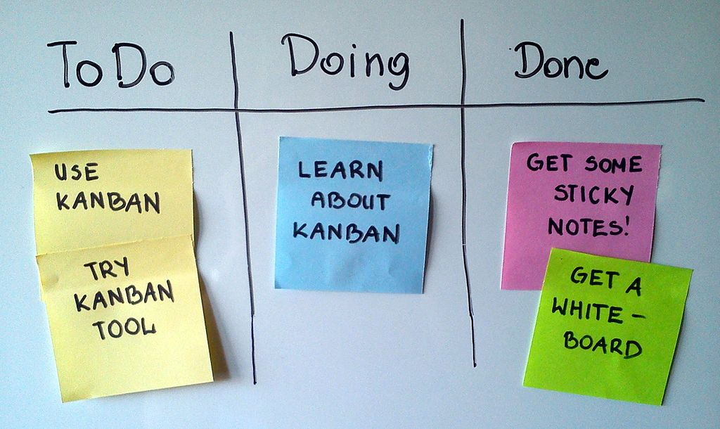
Kanban
Kanban is a d method focused on visualising all the steps needed to fully develop a product.
This is normally illustrated with the use of a Kanban board.
A Kanban board will be
divided into sections that
Represent the different
Stages in the development
Process.

Slide 5
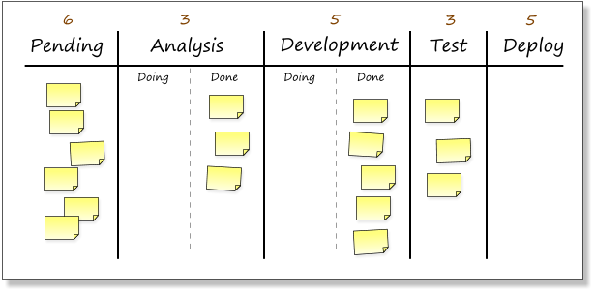
Kanban Board
Each item on the board represents an item or task going through the work process. Each section represents different stages in the work process and items are moved about accordingly to Illustrate the progress of the work.

Slide 6
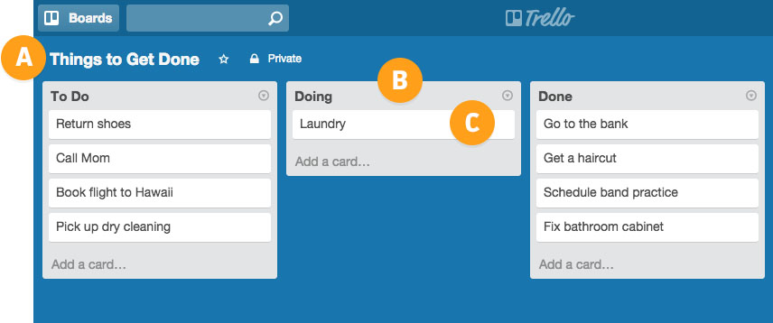
Trello
Trello is a Kanban based tool used for managing projects. Each project is shown as a “board” which contain lists, cards. Users can be assigned to cards and all of these can be grouped into organisations.

Slide 7

Slack
Slack is a chat application specifically designed for teams.
Features: Channels, Direct Messages, and Private Groups.
All messages accessible through search interface.

Slide 8


Revision Control
Revision control is the process of controlling and noting what version of a piece of software is being worked on and what changes have been applied. This allows you to back up your work and roll back to previous versions if a defect is found.

Slide 9

Originally developed as the Hudson project
Jenkins is a continuous integration server
Builds and runs tests whenever new code is pushed to provide fast feedback

Slide 10
Thanks for Listening
Any questions?

